Slide 1
AsiaGate Synergy Sdn Bhd
Company Profile
FEBRUARY, 2022

Slide 2
BACKGROUND
Founded
Combined years of expertise
Target active users
Revolutionises Fintech for Next-Gen empowerment
2020
AsiaGate established to align with perceived gaps in IR4.0 and new normal practices by taking into account the gaps within financial technology, IT Security and gateway technology facing the nation and the region.
100
8 M
Our plan involves new startup developments and partnerships to create an ecosystem capable to tap the opportunities in the intended sectors.
Our mission are
To have presence in Asian Region in payment solutions, remittances and cyber security
We target Fintech, Remittance and payment services which, over time to be able to have the capability of virtual banking.
To be the catalytic factor to grow national GDP, create jobs and strengthen national balance of payment
To be a “Malaysia First” security and infrastructure solutions to resolve currently known exposure and allow the country to take better control of it’s Network and IT security.
And our vision is
To empower the Next-Gen with revolutionized solutions and products

Slide 3
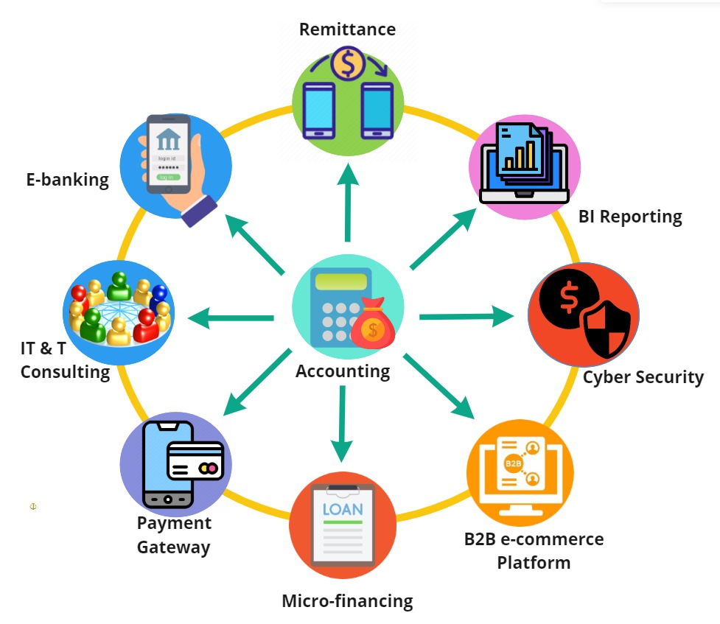
SOLUTIONS ECOSYSTEM
AsiaGate platforms developed around principled accounting and security systems that supplemented with business intelligence system that promptly respond to events and rationalize decision-making process:

Slide 4
SOLUTIONS ECOSYSTEM…continue
Accounting System
The core of the platform, accepting in details from the other platforms for sales and purchases, as well as providing for financial recording requirements of the modules for example reconciliation.
Payment Gateway System
Multi-Tenant Payment platform to enable transaction between vendors, banks and aggregators.
E-Wallet System
A mobile wallet with intention to expand to a digital bank account at a later point.
Remittance System
Multi-Tenant Remittance Platform as a Service (PaaS/SaaS) with aggregation.
B2B E-commerce Platform
A platform to enable CO-OP’s and SMEs to leverage on bulk purchasing and supplying to their members while supplying and passing on greater discounts.
Micro Lending Platform
A financial lending platform either by banks or P2P lending to provide faster and better value loans to SME’s and CO-OP Members.
BI & Analytics Platform
A smart analytics and BI gathering platform for use in ML/AI training and better understanding of the market.
Cyber Security Solutions
-Data encryption -Role-Based access control -Secure application logic -Adaptive Authentication -Monitoring

Slide 5
CORPORATE STRUCTURE

Slide 6
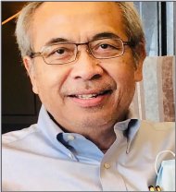
THE FOUNDERS
ABDUL LATIB
MANAGING DIRECTOR
Director of Finther Technologica from Jan 2012 – Oct 2018.
The company is a distributor for Riverbed products in Malaysia.
Among our customers are Telco Operators, corporations and major enterprises who are concerned to reduce their operating costs on
their telecom network and improving their overall network throughput performance.
Director of NKS from Jan 2015 – Dec 2017.
NKS provides integrated IT solutions, contracting works in fiber
infrastructure laying and telecom maintenance works. It has also extended its capability into providing higher technology solutions for
airport and military systems and solutions.
Executive Director at Ceres (Virgin Mobile) from Dec 2015 – Feb 2017.
Ceres is an MVNO company offering mobile services. It’s targeting
young segments and are marketed and distributed mostly through MLM.
Consultant at IDATE from Aug 2013 – Dec 2013, in Tehran.
IDATE is consulting firm based in Montpellier, France. It was engaged to provide broadband consultancy for a national operator in Iran.
Consultant at BT Telconsult from Jan 2013 – Jun 2013.
Engaged as consultant to provide consultancy for Indonesia on broadband services.
Chief Operation Officer at Televenture Global Network from Jul 2011 – May 2012.
Leading a team of experts in planning and designing international submarine cable from Malaysia to Indonesia.
Vice President of Telekom Malaysia from Jul 2005 – June 2011.
The job is to lead and manage Network Operations of TM for its
domestic and international networks, overseeing service delivery and service availability meeting customers’ highest standards
Mr. Abdul Latib was the Chief Executive Officer of TFP Solutions Berhad from Nov 2018 – Dec 2019, based in Kuala Lumpur. TFP is a company traditionally involved in ERP, SI and aggregation services. To leverage on its rounded capabilities, it begins to enter into telecommunications, financial technology, fintech mobile, e-sport and digital contents aggregation, and smart solutions for enterprises and varsities.

Slide 7
THE FOUNDERS
STEVE CLARKE
GROUP CTO
Head of IT (2019 – 2020) at ATX SDN. BHD.
ATX owns and operates a full fledge proprietary system to process all transactions electronically. The principal activity is to build and manage electronic payment collection platforms for their partners and clients.
Chief Technology Officer (2014 – present) at EZZY MOBILE.
Steven is accountable to design, build and implement the first Bank Negara fully approved electronic money service platform for money remittance via web using PHP and Laravel framework and for mobile devices using Android Java that is fully compliant with FATF, AMLA and ISO 20022. Develop Technology Roadmap to ensure alignment between Technology, Product and Business functions and drive strategic management and technical operational oversight to streamline operations and effectively reduce costs. Design and lead the development of cloud strategy and approach to implement a hybrid cloud platform with public network for application interfaces and a private network for data storage. Established joint venture partnership with AXIATA Group Berhad for regional distribution across 9 countries.
Chief Technology Officer (2011 – 2014) at SURF AXIS TECHNOLOGIES
Co-founded and served as CTO and Strategic Consultant for an IPTV system services company to deliver and implement IPTV system and services solutions for KLIA TV.
Project Manager & IT Security Consultant (2009 – 2011) at AXIHOST
He analyze, assess and identify current network and security risk for the e-Nelayan fuel subsidy management system for Malaysian government LKIM and Marine Departments.
Senior Project Manager APME (2006 – 2009) at SHELL IT INTERNATIONAL
Mr. Steven Clarke is the expert on cyber security; cloud & application security; incident handling & response; governance, audit & compliance framework; identity & access management & risk assessment. On the technical part, blockchain & distributed ledgers; Fintech regulations, big data engineering; cloud computing architecture (AWS); system solution architecture; database & network design and administration; server management.

Slide 8
GROUP AND SUBSIDIARY
AsiaGate group as the parent company with two subsidiary company which are:
Asia Remit
Commercializing the solutions and offerings
Fortified Tech
Implements the R&D and owns the platforms & system solutions
Asia Remit

Slide 9
ORGANIZATION CHART – ASIAGATE
ASIA GATE
Board of Directors
Managing Director
Head
Finance, Admin & HR
Head of Compliance
Group CTO
Outsource Services
Senior Developer-1
CoSec
SBU:REMITTANCE
SBU: eCommerce
Legal
Senior Developer-2
CEO
Manager
Product & Business Development
Engineer-1
Engineer-2
Manager
Operations & Strategic Partnership
Manager
Product & Business Development
Executive
Marketing
Engineer-3
Executive
Operations Support & Customer Service
Executive
Marketing
FORTIFIED TECH SDN BHD
Executive
Settlement & Transaction Approval

Slide 10
ORGANIZATION CHART – FORTIFIED TECH
FORTIFIED TECH SDN BHD
Board of Directors
CEO
FINTECH
SOFTWARE
CYBER
SECURITY
IT & TELECOM
CONSULTING & PROJECT MANAGEMENT
SaaS
Customer
Integration
Voice
Consulting
Software Development
Project Management
Security
Solutioning
Data
Engineering
Training
Operations & Maintenance
Surveillance & Monitoring

Slide 11
REMITTANCE - PLATFORM
Remittance platform from Malaysia to a receiving country:
CREDIT INTO BANK ACCOUNT
CREDIT INTO EWALLET
SENDER
ASIA REMIT APPS
& WEB BASED SYSTEM
NETWORK AGGREGATOR/
PARTNER MTO
CASH PICK-UP

Slide 12
COOPERATIVES - PLATFORM
Digital platform for cooperatives:
Tekun
MARA
ZAKAT Selangor
Membership
Application
Supply chain
Financing
GRANT PROVIDERS
Process
Record
Connect
MEMBERS
B2B APPS
& WEB BASED SYSTEM
COOPERATIVES
SUPPLY CHAIN
Whole-sellers
Food supplier
Goods supplier

Slide 13
CASHLESS SCHOOL - PLATFORM
Digital platform for cashless school:
TEACHER
Attendance report
Payment
Communication
STUDENT
SMART CARD
APPS
& WEB BASED SYSTEM
PARENT/
GUARDIAN
ATTENDANCE
CANTEEN
BOOKS &
STATIONARY

Slide 14
THANK YOU
“the things that's transforming is not the technology….. it’s the technology that is transforming us”

